Slide 1
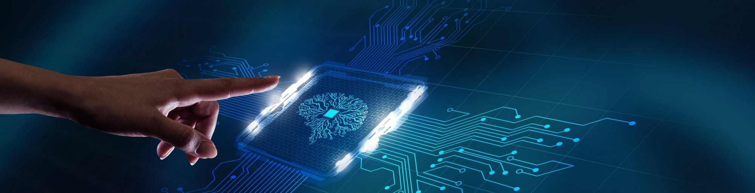
Hackathon Data Science
E-commerce Product Categorization PPT
Name: Hema N
Course: Data science bootcamp
Date: 4-08-2024

Slide 2
Problem Statement
Accurate product categorization is crucial for ensuring seamless customer experiences.
Current classification systems struggle to handle ambiguities, unconventional naming conventions, and multi-language data.
enhance product categorization efficiency, accuracy, and scalability.
Develop a text classification model that categorizes products with maximum accuracy based on description of the product.

Slide 3
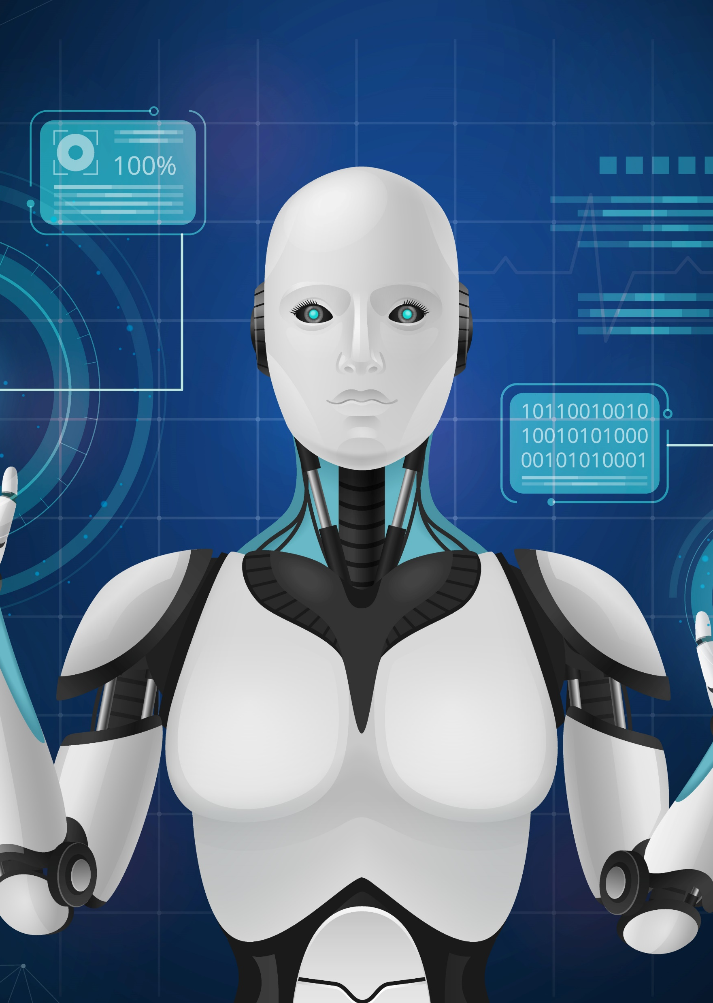
Objectives
01
Data Exploration and Preparation
04
Predictive Modeling
02
Descriptive Analysis
05
Fine Tuning
03
Feature Engineering/Text to Features
06
Enhance Categorization Accuracy

Slide 4
Data Exploration
1- Overview of the given dataset
2- Key features and initial observations from the dataset
3- Handling missing data and inconsistencies
4- Data preprocessing and cleaning the data

Slide 5
Descriptive Analysis
1- Here analysis to identify data patterns and category distributions are done.
2- Visualizations used: Word clouds, and pie charts for understanding the feature
3- Used Count plot to visualization to find data imbalances in the dataset

Slide 6
Feature Engineering
1- Spliting dataset into dependent and independent columns, Converted product descriptions into numerical features using TF-IDF vectorizer.
2- Custom feature extraction methods

Slide 7
Model Development
Developed models:
1- Logistic Regression
2- Decision Tree
3- Random Forest
4. Naïve Bayes
5. SVC
6-Used SMOTE to handle imbalanced data.
Note: Compared all the above models
7. Used One Deep learning model(Tensorflow-keras)

Slide 8
Fine-Tuning and Improvements
1- Hyperparameters were tuned and relevant features were selected.
2-We used gridsearchCV for mode hyperparameter tuning
Conclusion

Slide 9
Conclusion
Outcomes from Model
1.Successfully developed high accuracy model for product categorization
2.Successfully predicted category of items based on description of the product
Conclusion

